Slide 1


Phase 2 Project Seminar
Jawaharlal Nehru New College Of Engineering
Department of Computer Science and Engineering
Product Originality Detector using Blockchain
Rishabh Jayaram | 4JN22CS128
Rishika | 4JN22CS129
Rohith B S | 4JN22CS130
Sanketh S T | 4JN22CS141
Guide - Dr. Benakappa S. M B.E.,M.Tech.,Ph.D.
Coordinators – Mr. Vedananda D.E, Mrs. Radhika S.K
Date : 08-01-2026 and Time : 08:30-11:30

Slide 2
AGENDA
Abstract
Problem Statement
Objectives
Literature Survey
Motivation
Problem Statement
Objectives
Conclusion
Future Scope

Slide 3
ABSTRACT
In today’s global market, counterfeit products pose a significant threat to brand reputation, consumer safety, and economic integrity. The project presents an Originality Product Identification System leveraging Blockchain technology and QR codes to ensure the authenticity and traceability of products. The proposed system assigns each product a unique QR code, which is linked to a secure, tamper-proof record on a blockchain. At the time of manufacture, product data such as origin, manufacturer details, batch number, and timestamp are recorded on the blockchain. Consumers or stakeholders can scan the QR code using a smartphone application to instantly verify the product's originality and view its full history. The integration of blockchain guarantees data immutability and transparency, while QR codes provide a convenient and cost-effective interface for real-time verification.

Slide 4
Problem Statement
Counterfeiting is rising worldwide, negatively impacting product quality, brand reputation, and economies. Existing supply chain and authentication technologies such as QR codes and RFID have weaknesses like being easily cloned, centralized, and not transparent. These flaws make it difficult to effectively identify and prevent counterfeit goods. Hence, it is necessary to develop and use a secure and tamper-proof mechanism that enables authentication and traceability of products right from the producer all the way to the consumer. This is achieved through the creation of a decentralised blockchain-based anti-counterfeit product identification model that will help the various players in the chain to track and ensure that their products are legitimate, thus reducing on counterfeit products and hence enhancing consumer-confidence.

Slide 5

Objectives
The objectives of the proposed project include:
To design and develop a blockchain-based system to authenticate products and prevent counterfeiting.
To implement QR codes and smart contracts to enable transparency and tamper-proof tracking of products throughout the supply chain.
To empower consumers to verify product authenticity by scanning QR codes linked to immutable blockchain records.
To enhance supply chain transparency and trust among stakeholders by providing a secure platform for product genuinety.

Slide 6
Introduction
Uses Blockchain technology to securely store product information without tampering.
Customers scan a QR code to check if a product is original or fake.
Helps prevent counterfeit products and improves trust and brand safety.
Provides fast, transparent, and reliable verification across the supply chain.

Slide 7
LITERATURE SURVEY
SI.no | Author ,Year of publication | Methodology | Contribution | Advantages | Limitations
1 | Jayaprasanna M.C. et. al., (IEEE,2021) | Developed a Blockchain-Based Counterfeit Detection System using QR codes and a tamper-resistant database to verify products. | Introduced a secure, tamper-proof QR code verification system backed by blockchain to detect counterfeit products. | High detection accuracy (up to 98.8%), improved transparency, consumer trust, and supply chain traceability. | QR codes can be copied; requires user adoption and consistent manufacturer participation.
2 | R. Geeth et. al., (IEEE,2024) | Developed BQRPA system using blockchain and QR codes. Experimentally compared it with the CFPI method. | Introduced a secure, tamper-proof QR code verification system backed by blockchain to detect counterfeit products. | High detection accuracy (up to 98.8%), improved transparency, consumer trust. | QR codes can be copied; requires user adoption and consistent manufacturer participation.
3 | M. Pragadeesh et. al., (IEEE,2024) | Blockchain-based system using one-time printable QR codes and smart contracts for secure product authentication. | Introduced a dual-interface system to enhance traceability and reduce counterfeiting . | High transparency, user empowerment, scalable for SMEs, real-time verification . | QR code replication risk if physically copied.

Slide 8
LITERATURE SURVEY
SI.no | Author ,Year of publication | Methodology | Contribution | Advantages | Limitations
4 | Dhore ML et. al., (IEEE,2024) | Uses Ethereum, smart contracts, QR codes, and a React UI to verify product authenticity. | Introduces a secure and transparent platform for supply chain product verification using immutable blockchain records. | Provides real-time, tamper-proof verification with easy access and transparency for all users. | Requires high setup effort, cost, and reliable internet and blockchain infrastructure.
5 | Singhal I et. al., (IJRASET,2021) | The system uses blockchain technology with QR codes and smart contracts to verify product authenticity and track ownership. | It provides a decentralized solution to detect counterfeit products. | The system is secure and eliminates the need for third-party verification, reducing fraud in supply chains. | The blockchain may introduce scalability issues and require widespread adoption by users.
6 | Shankar BP et. al., (IEEE,2024) | The system employs QR codes combined with AES encryption and SHA-256 hashing to securely authenticate products. | It introduces a cost-effective, highly accurate solution for counterfeit detection and enhanced security. | Fast , scalable and compatible with low-cost products. | Internet connectivity in secure key may lead to adoption in offline environment.

Slide 9
SI.no | Author ,Year of publication | Methodology | Contribution | Advantages | Limitations
7 | Yen Xuan Lo et. al., (IEEE,2023) | Developed an Ethereum-based Dapp using Solidity, React, and Node.js for product authentication. | Introduced a decentralized, transparent anti-counterfeit system with secure QR code verification. | Ensures high security, transparency, and consumer-accessible authenticity checks. | High Ethereum fees and test net-only implementation limit scalability.
8 | Prathipa S et. al., (IEEE,2022) | Blockchain QR system with hash validation and expiry checks. | Time-sensitive QR codes with dual seller-product verification. | Seller accountability via QR codes and mobile accessibility. | QR vulnerability lacks payment integration, needs RFID upgrade.
9 | Vijay Mane et. al., (IEEE, 2024) | Ethereum blockchain with Solidity contracts and QR validation. | Real-time product verification with decentralized tracking system. | Tamper-proof traceability with user-friendly verification interface. | QR vulnerability needs RFID/biometric enhancements.

Slide 10
SI.no | Author ,Year of publication | Methodology | Contribution | Advantages | Limitations
10 | Keerthy G et. al., (IEEE,2023) | Combines blockchain and QR codes for product authentication. | Implements secure anti-counterfeit system with supply chain tracking. | Enhances transparency and reduces counterfeit risks effectively. | Faces adoption barriers and QR code vulnerability issues.
11 | Jhansi Devi et. al., (IEEE,2023) | Uses one-time scannable QR codes linked to product data in Firebase to verify authenticity. | Introduces a mobile-based system that connects physical products to a digital record to detect counterfeits. | Enables real-time verification, prevents tag cloning, and enhances supply chain transparency. | Limited scalability, potential QR reuse risks if not properly managed, and dependency on Firebase infrastructure.
12 | Mohammad Adnan Muzafar et. al., (IJPE,2023) | Hyperledger Fabric with QR codes for authentication. | Blockchain system enables real-time supply chain tracking. | Boosts transparency and consumer trust. | Costly implementation, needs technical expertise.

Slide 11
SI.no | Author ,Year of publication | Methodology | Contribution | Advantages | Limitations
13 | Anupriya Jha et. al., (IJPE,2023) | Blockchain‑based Hyperledger Fabric system integrated with QR codes and REST APIs for product traceability. | Proposes a comprehensive anti‑counterfeit supply chain solution combining digital ledger transparency. | Ensures secure, tamper‑proof tracking, automatic ownership transfer. | Significant organizational investment, technical expertise, scalability improvements.
14 | Dileep M R et. al., (ICACCTech,2023) | Blockchain (Hyperledger Fabric) + QR codes for product authentication | End‑to‑end anti‑counterfeit supply chain framework with consumer verification | Secure, transparent, efficient, boosts trust | High setup cost, technical complexity, scalability challenges
15 | Mrunal Mhatre et. al., (JASR,2022) | Uses Ethereum blockchain, Solidity smart contracts, and a React.js web interface to track product states via QR codes | Developed a decentralized system (BCPIS) allowing consumers to verify authenticity and track ownership history by scanning product codes. | Eliminates the need for expensive hardware like RFID and prevents database tampering through decentralized storage. | Public blockchain implementation faces scalability issues and transaction costs (gas fees) that may hinder mass adoption.

Slide 12
SI.no | Author ,Year of publication | Methodology | Contribution | Advantages | Limitations
16 | Jia Uddin et. al., (IJAAS,2024) | Utilizes a centralized MySQL database to store hashed passwords linked to QR codes, deleting the entry after the first verification scan. | Proposed a low-cost "one-time scan" verification lifecycle where the digital product identity is destroyed after use to prevent cloning. | Significantly lower implementation cost and faster processing time compared to blockchain or RFID solutions. | Relies on a centralized database which creates a single point of failure and vulnerability to SQL injection attacks.
17 | Sangeeta Gupta, et. al., (IEEE,2024) | AES encryption for data security, and an algorithm to reconstruct damaged QR bits. | Authenticates products and includes a reconciliation algorithm to read /QR labels. | Reduces customer wait times and ensures higher data privacy. | The system was only tested on a limited dataset of 1000 products.
18 | Yuanfeng Cai et. al., (IEEE,2016) | Theoretical analysis of blockchain properties applied to reputation systems to mitigate specific attack models like Sybil and whitewashing. | Analyzed the specific robustness of blockchain-based reputation systems against subjective versus objective information fraud. | Prevents the sale of counterfeits with cloned tags. | Cannot effectively prevent fraud where users conduct real transactions to leave fake subjective ratings.

Slide 13
SI.no | Author ,Year of publication | Methodology | Contribution | Advantages | Limitations
19 | Ishaan Singhal, et. al., (IJRASET,2021) | Uses an Ethereum decentralized application (Dapp) with MetaMask wallet integration to manage smart contracts for product registration. | Developed a Dapp that allows manufacturers to mint unique product assets and enables users to verify details without third-party intermediaries. | Provides complete transparency and immutability of the supply chain history, fostering trust between manufacturer and consumer. | Requires end-users to have technical familiarity with crypto-wallets (like MetaMask) and pay network transaction fees.
20 | Kentaroh Toyoda, et. al., (IEEE,2017) | Implemented an Ethereum-based proof-of-concept that requires sellers to cryptographically prove ownership before a sale, distinct from just possessing the product. | Developed a Dapp that allows manufacturers to mint unique product assets and enables users to verify details without third-party intermediaries. | Provides complete transparency and immutability of the supply chain history, fostering trust between manufacturer and consumer. | Requires end-users to have technical familiarity with crypto-wallets (like MetaMask) and pay network transaction fees.

Slide 14
Design And Implementation
1] System Architecture Overview:
Blockchain is used to store product data securely so it cannot be changed or hacked.
QR code is created for each product to help verify originality.
Users scan the QR code to instantly check if the product is genuine or fake.
Can be used in retail shops, warehouses, e-commerce, and manufacturing units to protect the supply chain.

Slide 15
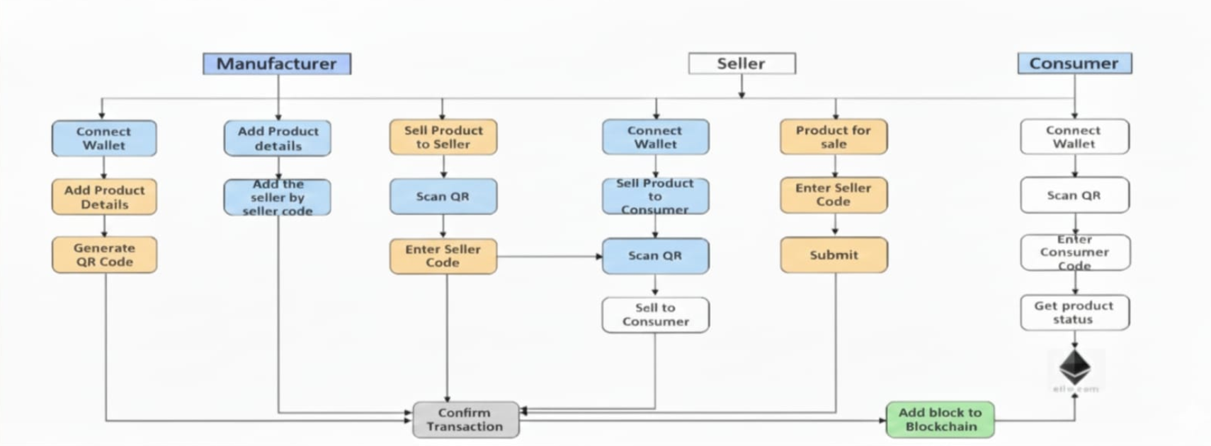
Flowchart

Slide 16
2] Product Registration on Block chain:
Smart contracts store product details securely on the blockchain
Written in Solidity, smart contracts manage product information like product ID and batch number.
Immutable storage means data cannot be changed once recorded
Tamper-proof records help prevent fake or altered product information.
Decentralized verification checks data through a distributed network instead of a single authority.

Slide 17
3] QR Code Generation Module:
Each product is assigned a unique encrypted QR code linked to block chain data.
• The QR code contains a unique hash or product ID mapped directly to smart contract entries.
•QR code is printed on packaging or labels for consumer and retailer verification.
•The module ensures that QR codes cannot be duplicated or reused fraudulence.

Slide 18
4] Data Collection and Preprocessing:
Collects product details like name, batch ID, serial number, and expiry date.
Validates product information before saving it to the blockchain.
Ensures accuracy and correctness of data to avoid errors.
Converts product details into a structured format (JSON).
Prepares data for smart contract storage and Web3 interaction.

Slide 19
5] Training and Optimization:
Machine learning helps detect fake or tampered QR codes automatically.
Models analyze suspicious scanning patterns to identify possible fraud.
Accuracy, precision, and recall are used to improve detection performance.
Helps increase reliability in identifying counterfeit products.

Slide 20
6] Detection Implementation:
Web3.py or Web3.js is integrated to enable communication between the frontend and block chain network.
When a user scans the QR code using a mobile app or scanner, the system retrieves product details from the block chain.
The system compares the scanned ID with block chain records:
If the product exists → Marked as Original
If not found or modified → Marked as Fake

Slide 21
7] Deployment and Use Case Integration:
Can be used in retail stores, warehouses, transport hubs, and online platforms.
Provides instant product verification for customers, sellers, and authorities.
Manufacturers can add new products through a dashboard.
Works with barcode scanners, mobile apps, and web portals.
Helps secure the entire supply chain from production to delivery.

Slide 22
MOTIVATION OF SELECTING THIS PROJECT
Combat Counterfeiting.
Leverage Block chain for Good.
Empower Consumers.
Enhance Supply Chain Integrity.
Interest in Smart Contracts & Dapps (Decentralized apps).
Interest in Supply Chain Innovation.
Encourage Regulatory Compliance.
Support Ethical Business Practices.

Slide 23
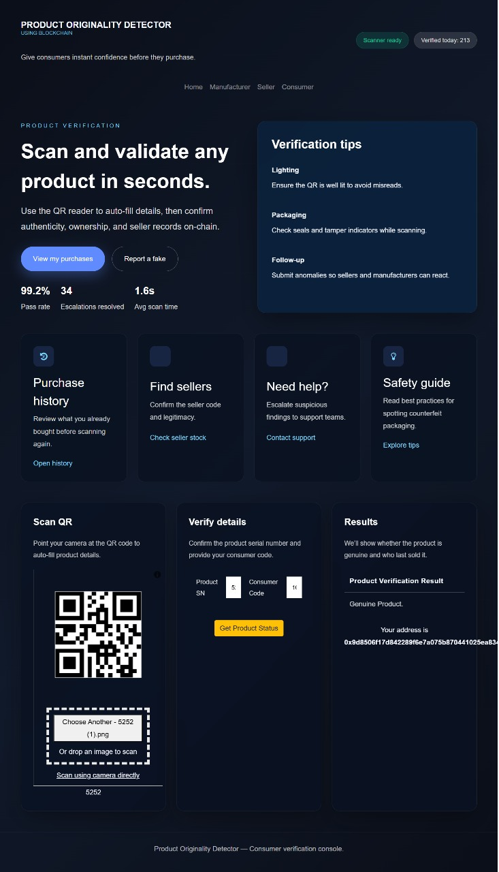
Results:
Figure 4.1 Final Outlook of Blockchain-Based Authenticity Detection GUI

Slide 24
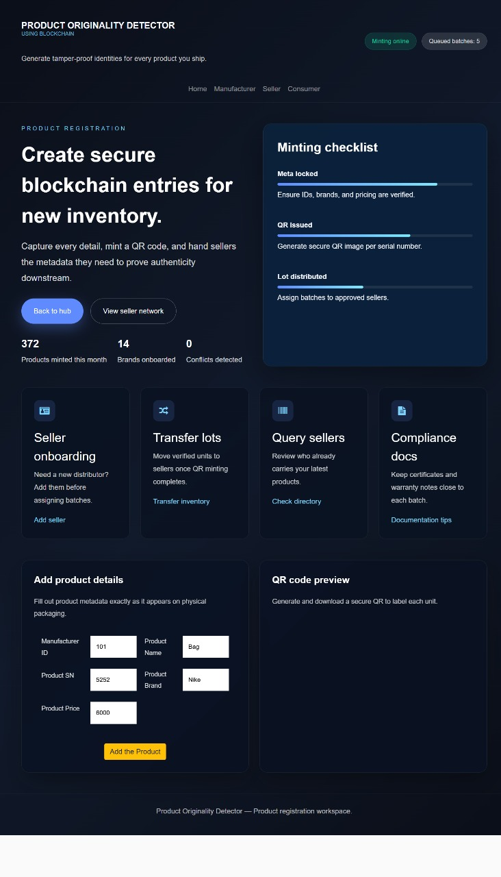
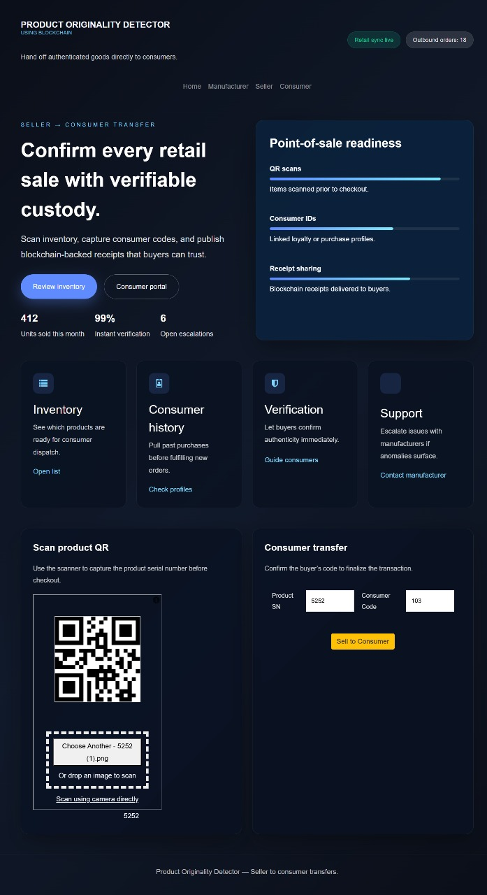
Product Authenticity Verification Button
Figure 4.2 Output of Product Verification Button for Blockchain Minting and QR Generation
Figure 4.3 Output of Blockchain Originality Detection Button for Verified Product Scan

Slide 25
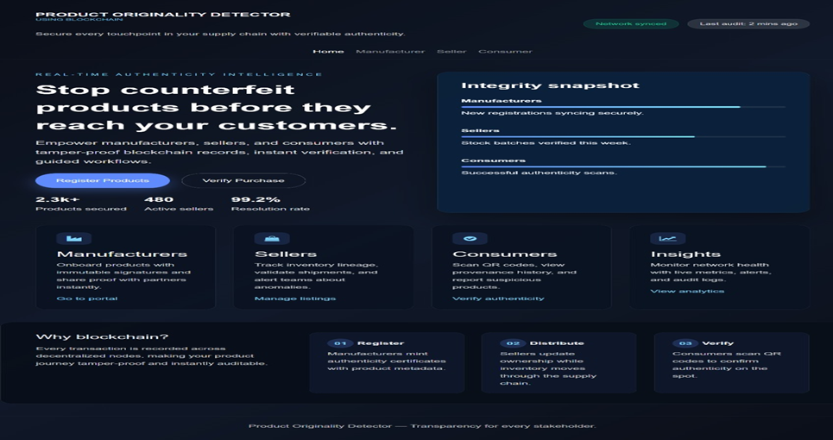
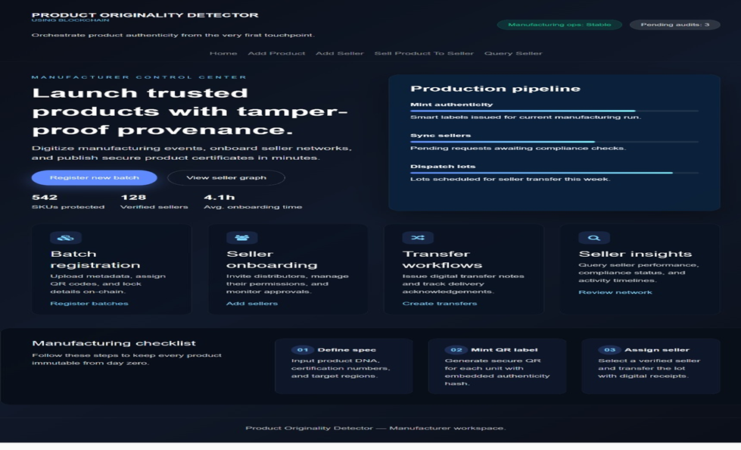
Figure 4.4: Product Authenticity Check Result
Displaying High Confidence Non-Original Status
Figure 4.5: Product Verification Result Displaying Incomplete Scan Caused by Obstruction

Slide 26
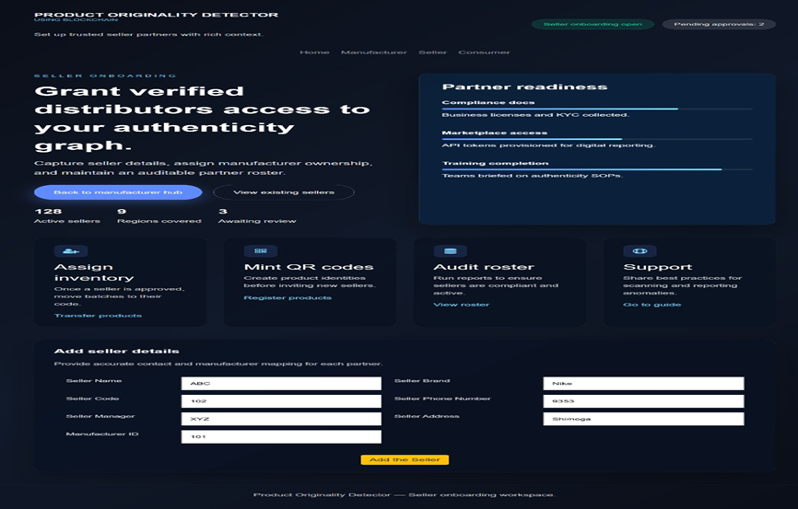
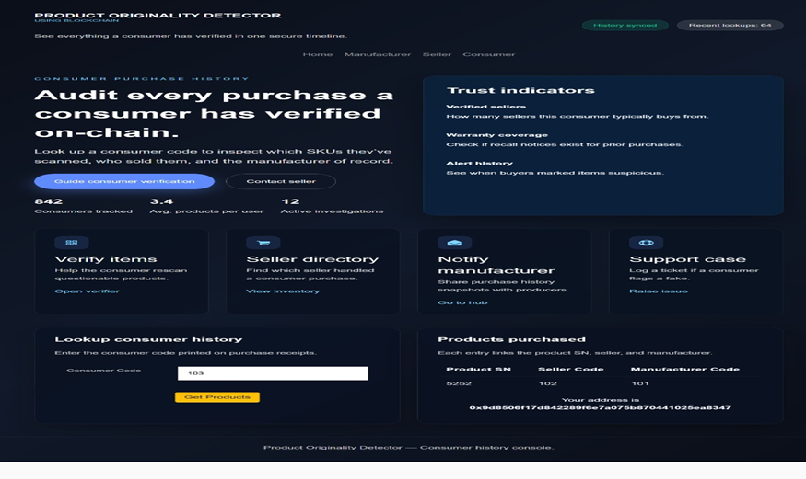
Seller Management Button:
Figure 4.6: Seller Registration Button Output
Figure 4.7: Consumer Verification Button Output

Slide 27
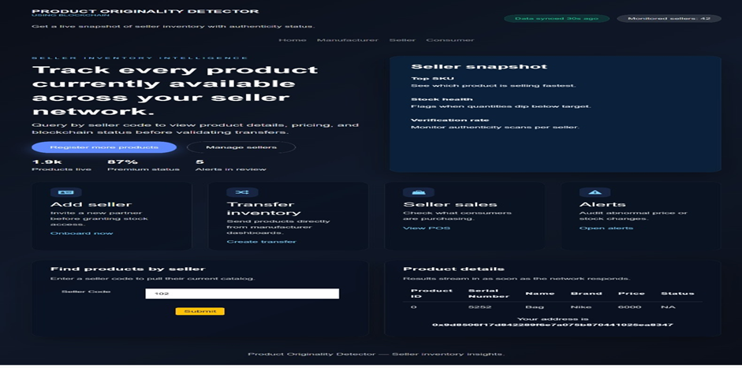
Figure 4.8: Seller Inventory Button Output

Slide 28
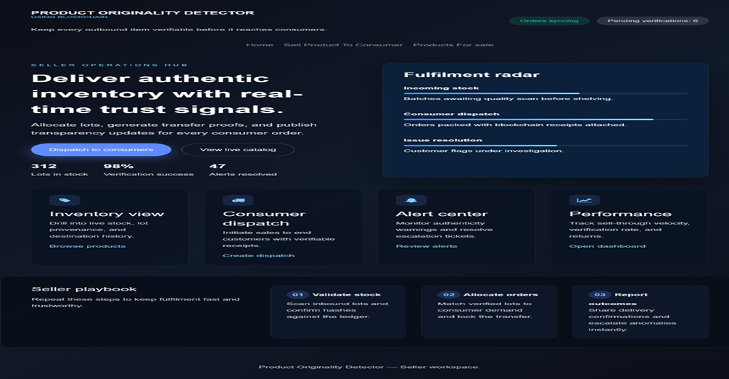
Figure 4.9: Seller Operations Button Output

Slide 29
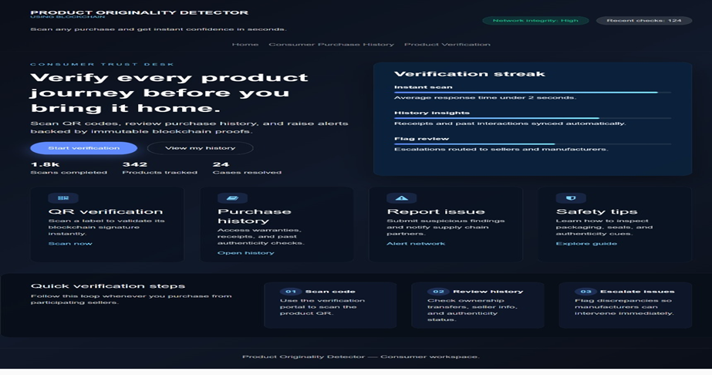
Figure 4.10: Consumer Verification Button Output

Slide 30
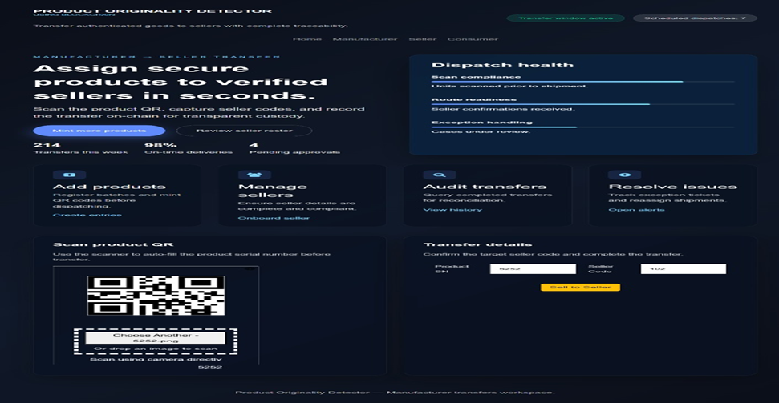
Figure 4.11: Manufacturer Transfer Button Output

Slide 31
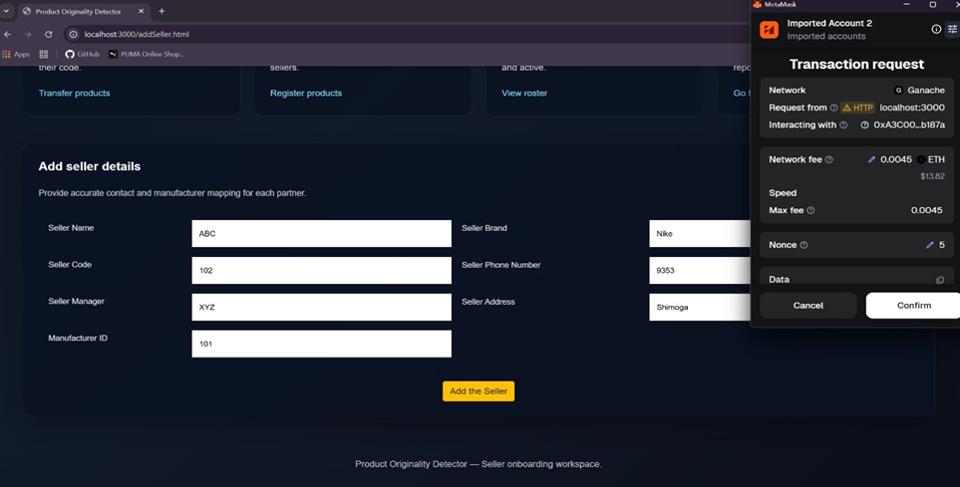
Figure 4.12: Add Seller Transaction Confirmation Output

Slide 32
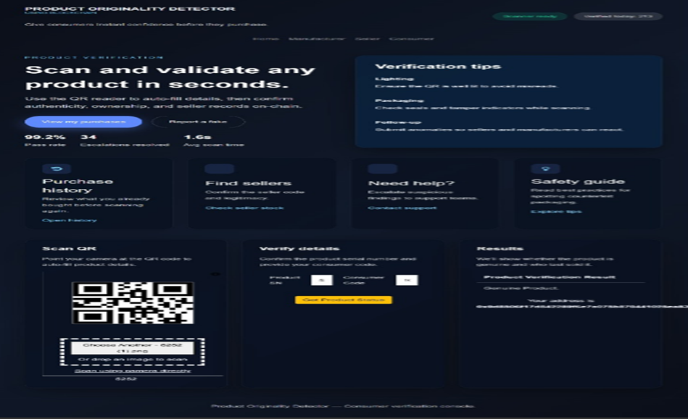
Figure 4.13: Product Verification Interface Output

Slide 33
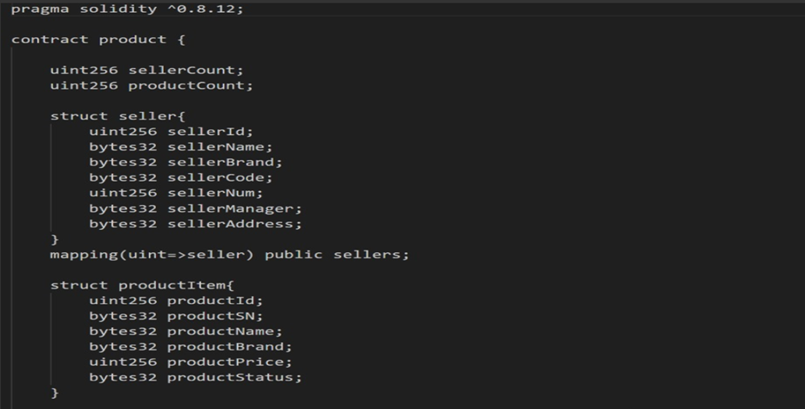
Code Snippets
Figure 4.14: Smart Contract Structure for Product and Seller Management

Slide 34
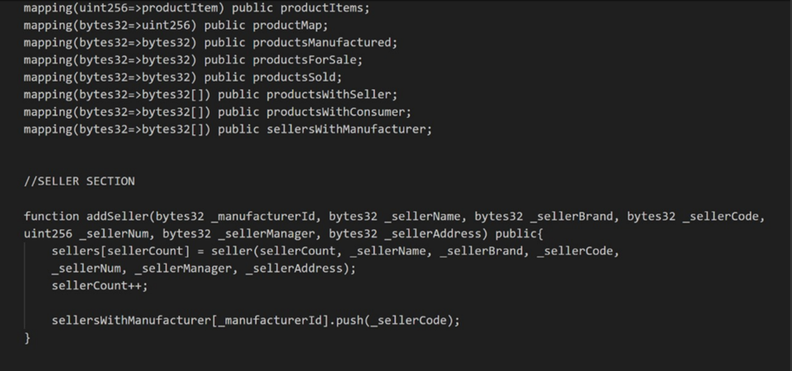
Figure 4.15 : Navigation Structure Linking Major User Roles

Slide 35
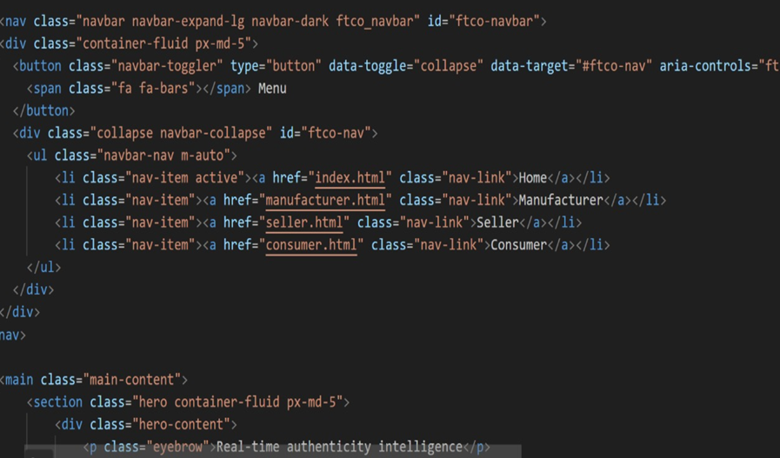
Figure 4.16: Homepage Feature Grid for User Interactions

Slide 36
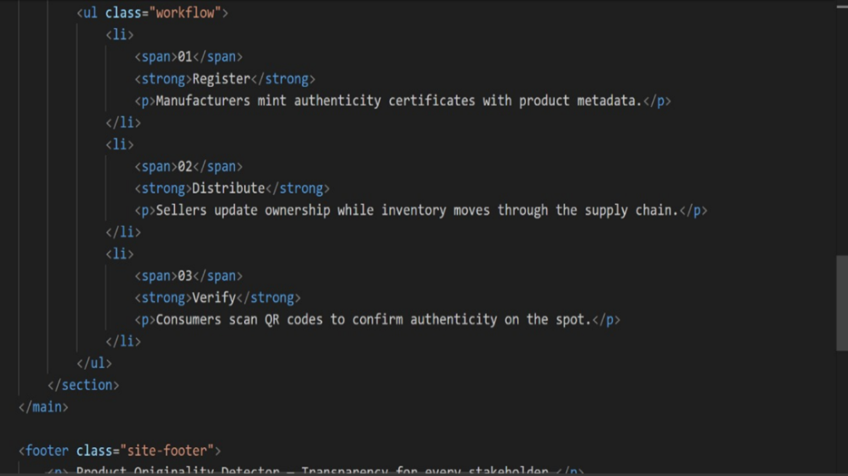
Figure 4.17: System Workflow for End-to-End Product Traceability

Slide 37
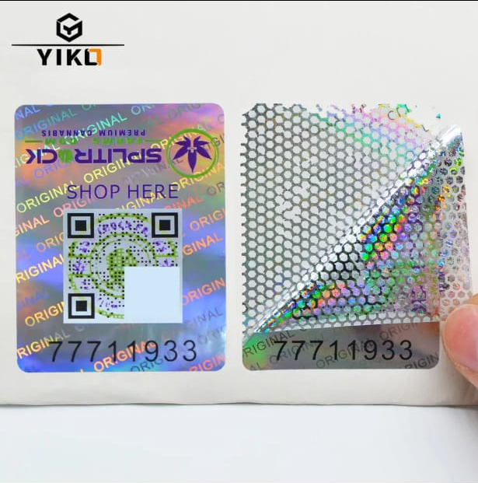
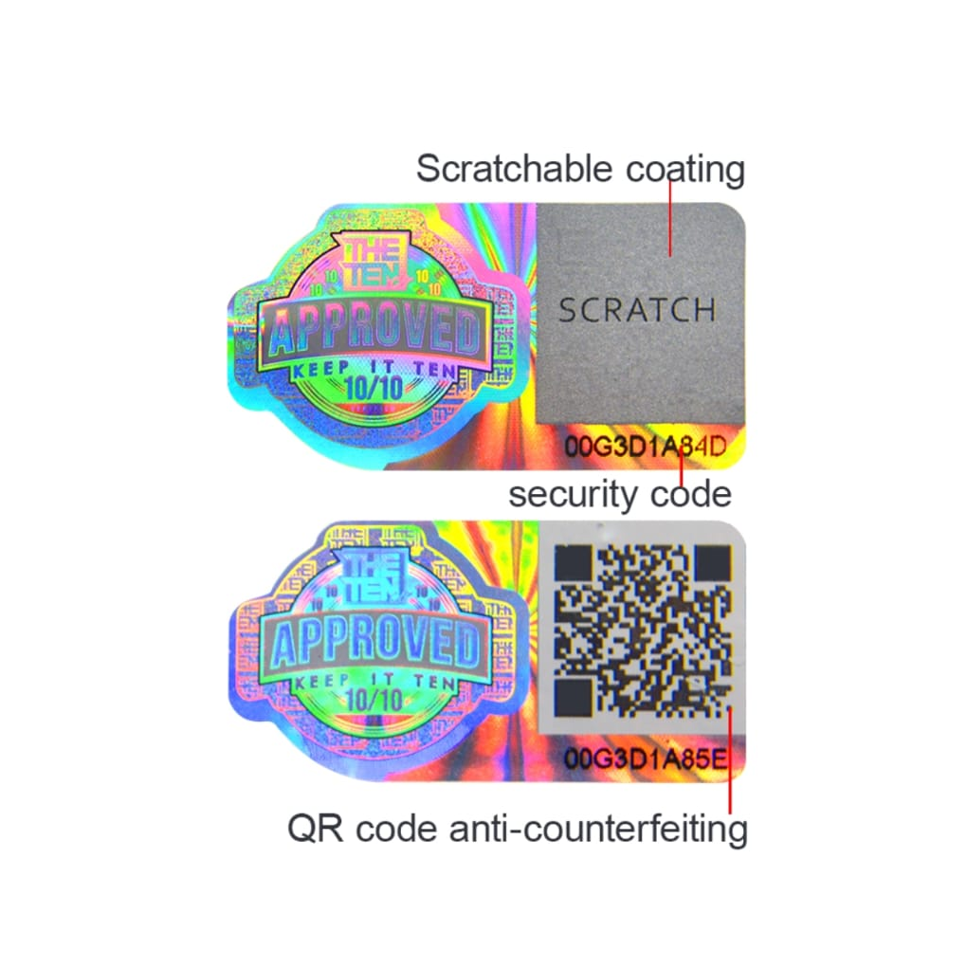

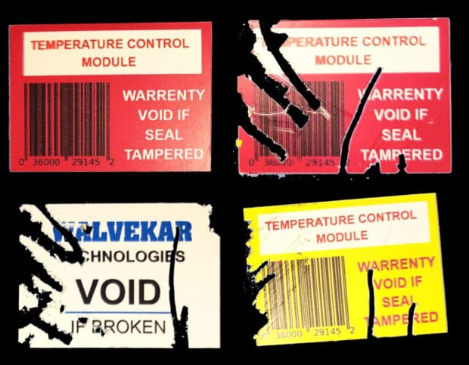
METHODS TO PASTE ON OBJECTS

Slide 38
Conclusion
The Product Originality Detector Using Blockchain provides a secure and effective solution for verifying product authenticity and preventing counterfeiting. By storing product details on a tamper-proof blockchain network and enabling real-time verification through QR code scanning, the system ensures transparency, trust, and reliability across the supply chain. This approach not only helps consumers identify genuine products but also supports manufacturers in protecting their brand and maintaining product integrity.

Slide 39
Future Scope:
Integration with IoT and Smart Packaging
Global Supply Chain Expansion
AI-based Fraud Detection
NFT-based Product Ownership Certificates
Government and Legal Verification Integration

Slide 40
REFERENCES
[1] | Jayaprasanna M.C., Soundharya V.A., Suhana M., Sujatha S. A block chain-based management system for detecting counterfeit product in supply chain. Third International Conference on Intelligent Communication Technologies and Virtual Mobile Networks (ICICV), 2021 Feb 4 (pp. 253–257). IEEE.
[2] | Geetha R, Jayakumar D, Prabakaran P, Nivedha S, Sindhu M, Thivyarathi RC. An Experimental Evaluation of an Effective QR Code Based Duplicate Product Detection Using Blockchain Technology. In2024 International Conference on Intelligent Systems for Cybersecurity (ISCS) May 3 (pp. 1-7) IEEE [2024].
[3] | Pragadeesh M, Vignesh BK, Ashraf SM, Kumar RD. Anti-Counterfeiting Solution for Product Authentication Using Blockchain. In2024 Second International Conference on Emerging Trends in Information Technology and Engineering (ICETITE) Feb 22 (pp. 1-4). IEEE [2024].
[4] | Dhore ML, Loya R, Sasne R, Rokade T, Chandak R. Anti-Counterfeit Product Identification System: A Paradigm Shift in Supply Chain Integrity. In2024 8th International Conference on Computing, Communication, Control and Automation (ICCUBEA) 2024 Aug 23 (pp. 1-6). IEEE [2024].
[5] | Singhal I, Bisht HS, Sharma Y. Anti-counterfeit product system using blockchain technology. Int. J. Res. Appl. Sci. Eng. Technol. 2021 Dec;9(12):291-5.
[6] | Shankar BP, Rajkumar N, Viji C, Kumar KD, Saravanakumar S, Mohanraj A. Approach to Identifying Counterfeit Products with QR Codes and Computational Algorithms. In2024 5th International Conference on Smart Electronics and Communication (ICOSEC) Sep 18 (pp. 1203-1209). IEEE [2024].
[7] | Lo YX, Tan CC. Blockchain-Based Anti-Counterfeit Product Identification System. In2023 IEEE International Conference on Artificial Intelligence in Engineering and Technology (IICAIET) Sep 12 (pp. 200-205). IEEE [2023].

Slide 41
[8] | Prathipa S, Harish K, Thashanmouli N. Counterfeit product detection in supply chain management with blockchain. 1st International Conference on Computational Science and Technology (ICCST) Nov 9 (pp. 841-844). IEEE [2022].
[9] | V. Mane, R. Patil, S. Pawar, and N. Pujari, “Detection of Counterfeit Products with QR Codes using Blockchain Technology,” in 2024 International Conference on Circuit Power and Computing Technologies (ICCPCT), 2024, pp. 545–550.
[10] | Keerthy G., Neha Rohith, Hemanth B.G., Amay Deepak Nayak, and 5D B. Srinivas, “Enhancing Product Authentication and Counterfeit Detection Using QR Codes and Blockchain Technology,” Proceedings of the Second International Conference on Edge Computing and Applications (ICECAA 2023), IEEE, pp. 262–267, 2023.
[11] | Jhansi Devi P, Gutti D. N, Dutta M. S, Domakuntla S. K & Damerakonda M. (2023). One Time QR-Code for Fake Product Identification. Proceedings of the 5th International Conference on Inventive Research in Computing Applications (ICIRCA 2023), IEEE. ISBN: 979-8-3503-2142-5.
[12] | M. A. Muzafar, A. Bhargava, A. Jha, and P. Nand, "Securing the Supply Chain: A Comprehensive Solution with Blockchain Technology and QR-Based Anti-Counterfeit Mechanism," International Journal of Performability Engineering, vol. 19, no. 5, pp. 312323, May 2023.
[13] | Singhal I, Bisht HS, Sharma Y. Anti-counterfeit product system using blockchain technology. Int. J. Res. Appl. Sci. Eng. Technol. 2021 Dec;9(12):291-5.

Slide 42
[14] | K. Wasnik, Sondawle R. Wani, and N. Pulgam, "Detection of Counterfeit Products using Blockchain," ITM Web of Conferences, vol. 44, pp. 03015, 2022.
[15] | D. M. R, S. A. M. G Shukur, and M. G. Shukur, "Securing Authenticity: A Frontier Blockchain-Powered Fake Product Detection via QR Codes," 2024 Second International Conference on Advanced Computing & Communication Technologies (ICACC Tech), pp. 188–194, 2024.
[16] | K. Toyoda, P. T Mathiopoulos, I. Sasase, and T. Ohtsuki "A Novel Blockchain-Based Product Ownership Management System (POMS) for Anti-Counterfeits in the Post Supply Chain," IEEE Access, vol. 5, pp. 17465–17477, 2017.
[17] | Cai Y, & Zhu D. (2016). Fraud detections for online businesses: A perspective from blockchain technology. Financial Innovation, 2(1), 20.
[18] | Gupta S, Kuchipudi R, Sohail M, Singh K, Mahalakshmi J & Sarabu A. (2024). Fake product identification for small and medium firms (FPISMF) using blockchain technology. Measurement: Sensors, 33, 101164.
[19] | Hossain M, Begum M, Das B. C & Uddin J. (2024). A cost-effective counterfeiting prevention method using hashing, QR code, and website. International Journal of Advances in Applied Sciences (IJAAS), 13(2), 351–359.

Slide 43
[20] | Mhatre M, Kashid H, Jain T & Chavan P. (2022). BCPIS: Blockchain-based Counterfeit Product Identification System. Journal of Applied Security Research.

Slide 44
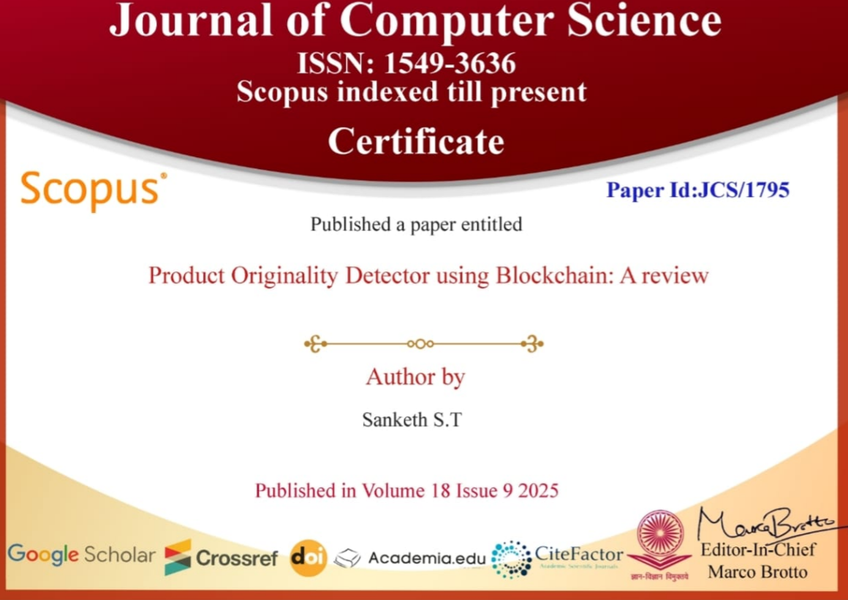
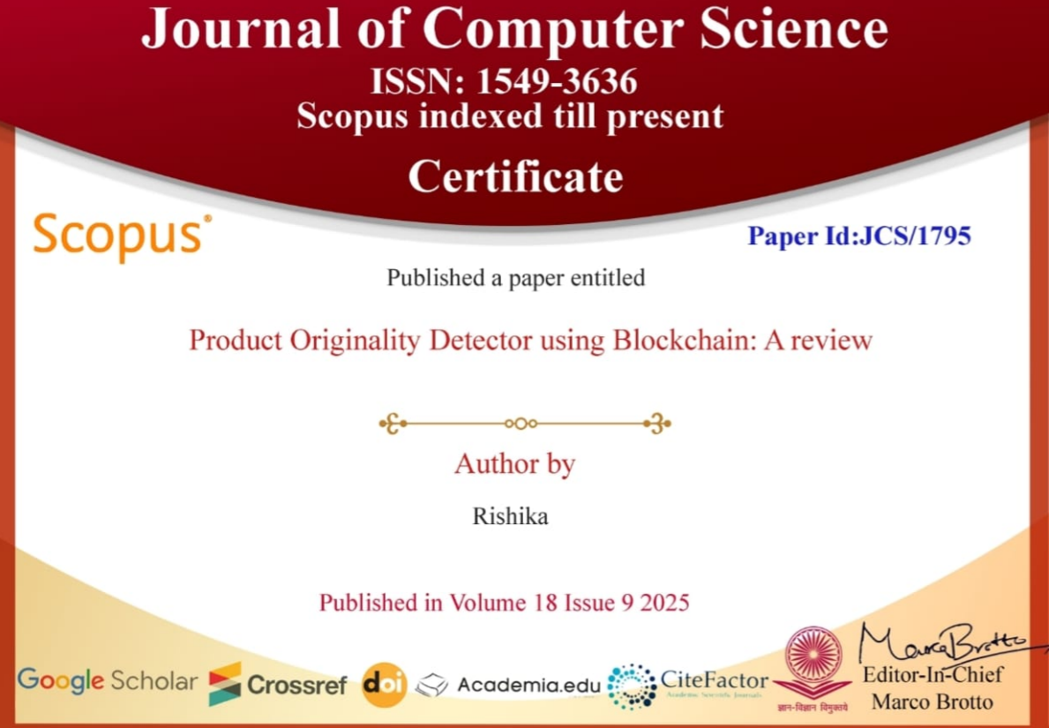
Paper Publication

Slide 45
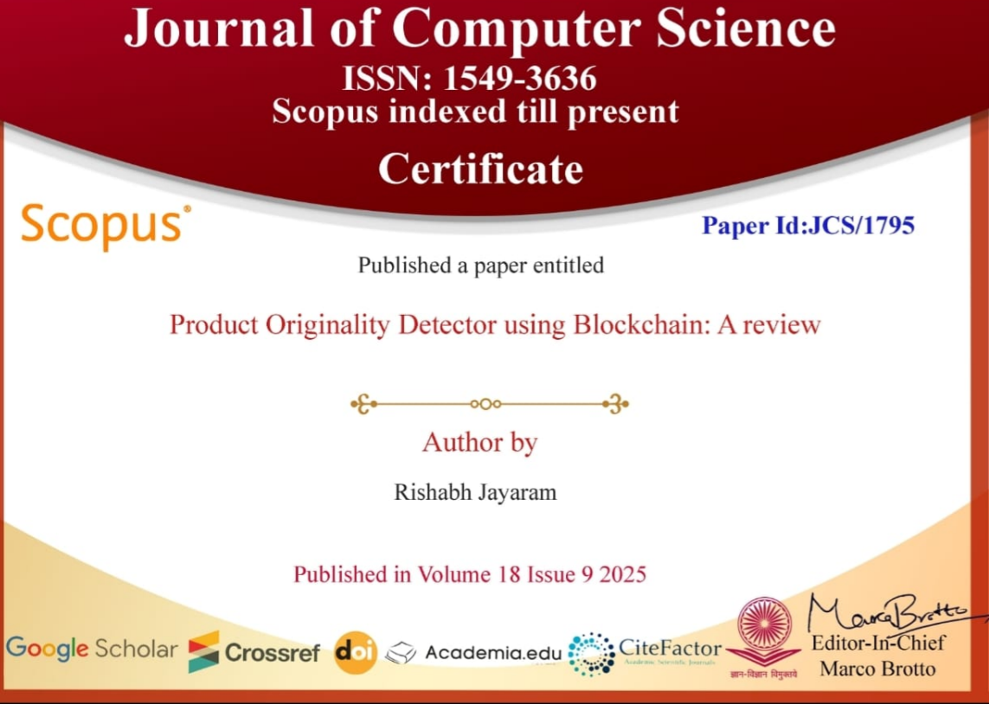
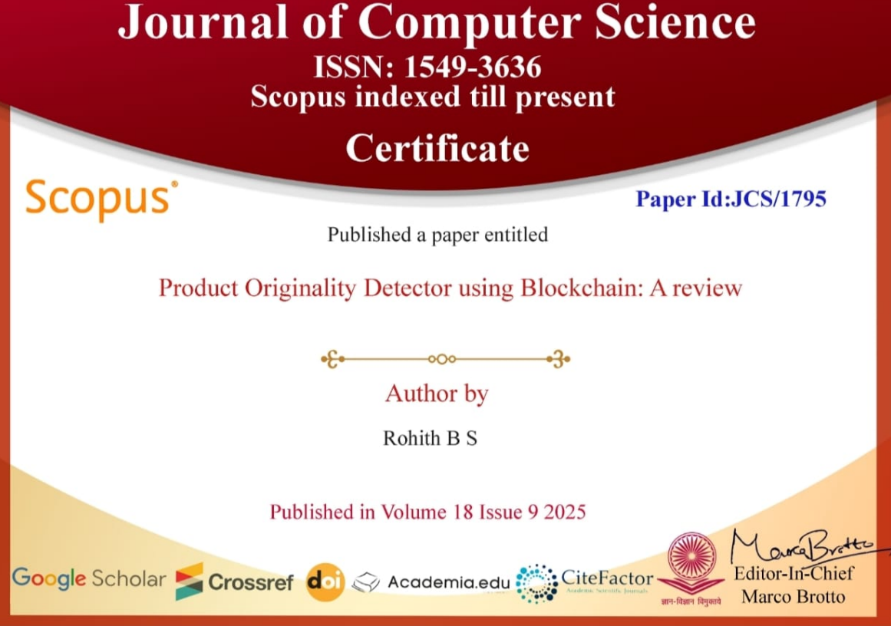

Slide 46
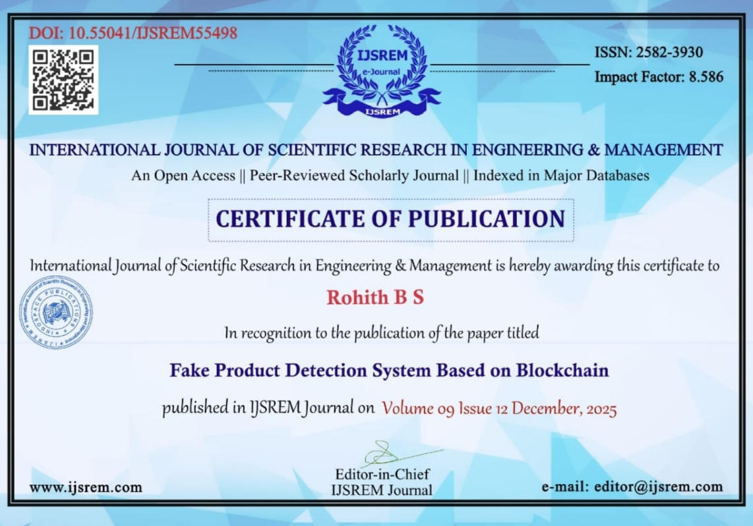


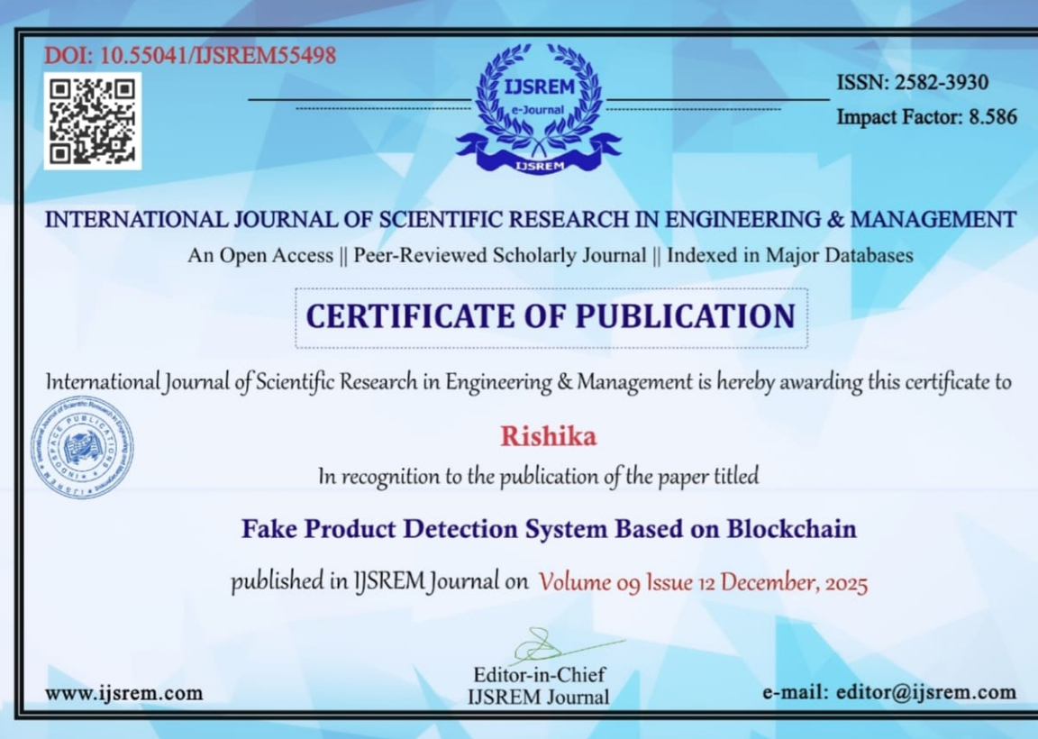

Slide 47


